Slide 1
(A)Listen, number and choose.

Slide 2
(A)Listen, number and choose.

Slide 3
(A)Listen, number and choose.

Slide 4
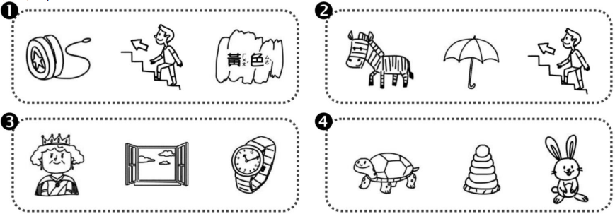
(B)Listen and choose.

Slide 5
(C)Listen and choose O or X.

